Slide 1

How to terraform
Anton Hryshchanka, L4, Software Engineer
.NET C# Backend/Full-stack
Stop clicking your mouse
Let's terraform something
Notes:
I’m L4 software engineer
Usually, I develop backends on .NET Core C# stack. But sometimes I’m working outside my primary skills and DevOps activities take big part in my tasks. Based on my experience, in the past 5 years, cloud configuration is a common task for many developers.
Very common task is creating database, backend and frontend, create host in cloud, deploy customer application into the cloud, setup configuration.
First problem is kept it in actual working state, fix issues in configuration.
Next problem is creating several similar environments like dev/test/pre-prod/prod for Continuous Delivery. And again, all environments must be in equals or similar state. Any change on dev environment must be applied for next environments.
Let’s look at one of the possible ways to close all questions above, automate and simplify the process.

Slide 2
Infrastructure as a Code
Infrastructure as Code (IaC) is the managing and provisioning of infrastructure through code instead of through manual processes
Pros:
I can store/extend/update infrastructure in several lines of code because they are files in the repository
I can share my infrastructure with other teams or people, review and track all changes in one place
???
Cons:
???
Notes:
First, let’s talk about Infrastructure as a Code approach.
Definition for Infrastructure as a Code you can see on slide.
A short and simple description is "ability to store the definition and configuration for something as code".
pros 1-2: I should say the main and important point for me is the ability to define something in a cloud in several lines of code. Possible to share it with teammates, view history of changes in git.
There is no need to click the mouse or remember the pattern for naming services.
I don't need to remember differences in configuration for test environment and production.
Sound great, looks like silver bullet and can solve all problems. No negative moments, all ok. Let’s investigate it.

Slide 3
Terraform by HashiCorp
Terraform is a tool for building, changing, and versioning infrastructure safely and efficiently. Terraform can manage existing and popular service providers as well as custom in-house solutions
website: https://www.terraform.io/
sources: https://github.com/hashicorp/terraform
forum: https://discuss.hashicorp.com/c/terraform-core/27
tool: Terraform CLI
Key features:
Infrastructure as Code
Execution Plans
Resource Graph
Change Automation
How to install:
download from https://www.terraform.io/downloads.html / unpack / add to PATH
compile binary from https://github.com/hashicorp/terraform.git / add to PATH
> brew install terraform
Notes:
On the current project we could choose any tool. The main idea was to use the IaC approach and automate management of the infrastructure as much as possible. Prevent any manual configuration, have stable and repeatable environment. We do not have DevOps, only backend and frontend engineers.
[Key Features]
[Installation]
[Image]
- cli tool
- tf files
- cloud provider and cloud
- state
- resources can have dependencies
- possible to change tf files and re-run CLI tool many times
[3 states]
- join together

Slide 4
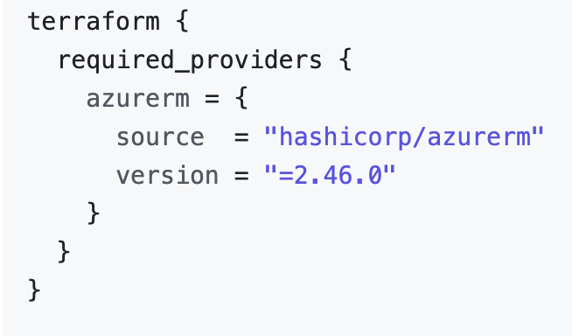
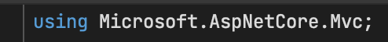
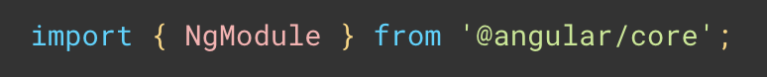
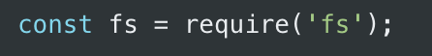

Notes:
Terraform uses HashiCorp Configuration Language. It is a very simple and untestable language with minimal features, a system of types, have functions for strings, collections, numbers etc., have logical operations, local and input variables, have modules system, and more.
[No magic]
After installation, Terraform CLI know nothing about Azure, AWS, Google Cloud, GitHub and other. Terraform uses something named as ‘provider’. Based on my understanding and sources on GitHub, provider is intermediate layer or library for communication between terraform and infrastructure (some api, demon, tool and etc.).
We can use more that 1200 providers.
[Open Link] https://registry.terraform.io/browse/providers
[Click]
Provider installation very similar to ‘using’ in c#, import in typescript, require in nodejs or import in Python.
Important moment is require_provider directive, source and version. It allow define name and version of provider. After run command terraform init, terraform will automatically check downloaded provider and download in case provider missed.
Is it clear? Any questions?

Slide 5
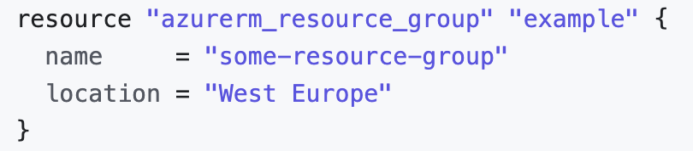
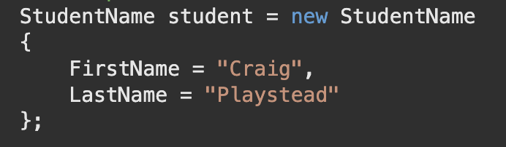
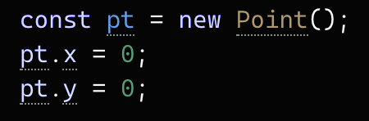
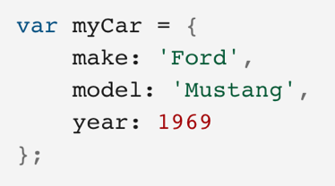
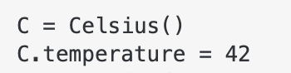
Notes:
After installation of provider, we can work with resources in provider. Resource very similar to type and/or object with information about something. Like order or user account.
If we are talking about Azure, we can use resource group.
[Click]
Resources very similar for creating new object in c#, typescript, nodejs or python.
Keyword resource similar var/let/const and etc. Next part is a type of resource line int/string/object/number and etc, on the screen our type is azurerm_resource_group. Name of resource example.
Is it clear? Any questions?

Slide 6
DEMO #0
HCL syntax and minimal example
Notes:
Let’s imagine situation when we need SQL database for some pet project or test. I can’t create it because my OS do not allow install server, or I don’t like install server. But I can create database in cloud. I can create it manually, but this process will take 10-15 minutes, I must fill several fields and I must remember password. In case any mistake, I have to repeat process and will take additional 10 minutes. Other possible approach is to use terraform.
First of all, let’s check my azure resources groups list. It has to be empty.
[Check Cloud] https://portal.azure.com/
[Run terminal commands]
Open main.tf and explain:
- provider section
- show provider (open in browser)
- explain 3 resources
- references between resources
- not secure password
[Explain terminal commands]
Do you have any questions?
[Explain terminal output]
Do you have any questions?
[Explain state file]
Do you have any questions?

Slide 7
DEMO #1
another provider
Notes:
Terraform can work not only with azure cloud. terraform can create repositories and project in azure devops.
Open main.tf and explain:
- other provider microsoft/azuredevops
- new types of resources
- ...
Please take a look and try remember names of project and repository.
This small demo with other provider just preparation for another big piace of terraform features. We will extend this resources little later.
Already runned and all what need created in cloud.
[Open DevOps and show]
- left menu features of the projects
- branch policies

Slide 8
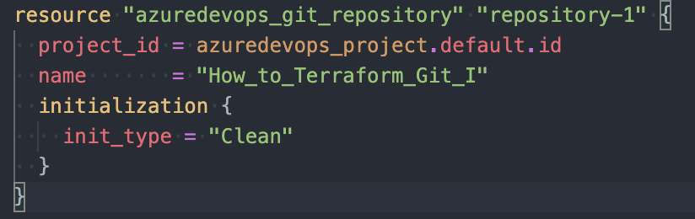
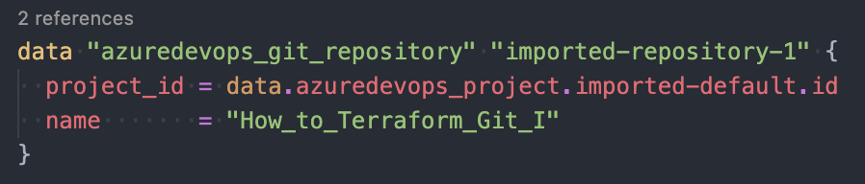
Notes:
Other important feature is data source.
On the slide you see resource of type git repository. Name of it How_to_terraform_Git_I. And have reference to project.
On the other image you can see import of already created resource as data source. Name of imported resource How_to_terraform_Git_I.
The difference in images is type of words: resource and data, type of both the same, property name for each the same.
project_id is a references, similar that we see previously in database demo, or in project and repositories demo.

Slide 9
DEMO #2
extend existing resources
Notes:
For clear understanding next demo, we will use infrastructure created in previous demo. But let's think that all resources was created manually many days ago.
Let’s try to understand what to do in case we like to use terraform, but a lot of resources already created, and impossible to re-implement it in terraform.
Let's extend existing resources from previous demo with Terraform.
[Show branch]
[Show branch policy]
[Show features]
[Explain code]
[Run commands]
[Show differences]

Slide 10
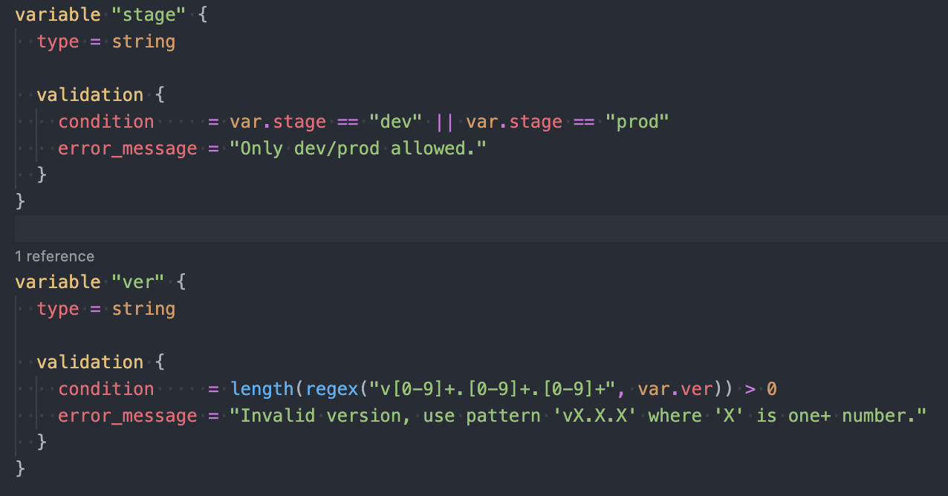
Notes:
Next important feature is input variables. Allow pass configuration values on plan/apply step outside the terraform files.
On scree you see 2 variables. Both have type string and define validating rules.
First validation check stage name, possible only dev and prod, but list can be extended.
Second validation rule more interesting. We are expecting version in semver format. We use regular expression for checking match with template and after that check number of matches.
We can pass values for variables as command line arguments, create special file with variables (I'll show this approach little later) or use Environment Variables as values for terraform.
Is it clear? Any questions?

Slide 11
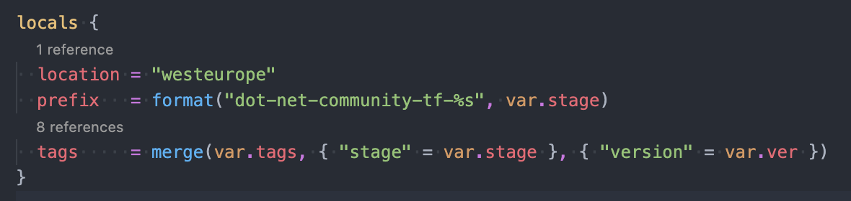
Notes:
Next important feature is local values. Local values like local variables in some method. We can initialize local values in runtime, create based on input values, use functions etc.
Is it clear? Any questions?

Slide 12
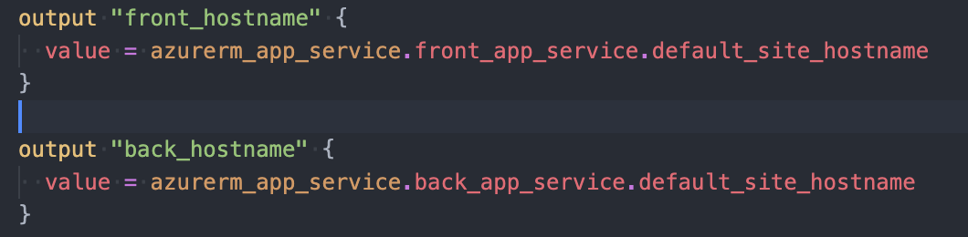
Notes:
And final feature for the final demo is a output values. We can define these values and after success terraform execution we can get all require information. On the screen we put in output host name. But it can be any important value. For example, app service name, SQL server name, name of resource group etc.
It very useful in DevOps pipelines. My actual project release pipeline does not have hardcoded values app services and database, we parse all require for deploy information from terraform output.
Is it clear? Any questions?

Slide 13
DEMO #3
real world example
Notes:
[Set HEAD to correct branch]
[Explain current data in file]
[Explain TFVARS]
[Run terminal commands]
[Set HEAD to correct branch]
[Explain current data in file]
[Run terminal commands]
[Set HEAD to correct branch]
[Explain current data in file]
[Run terminal commands]
[Run outputs from terminal]
[Run outputs from terminal in json]
[Check Azure resources]

Slide 14
Infrastructure as a Code
Infrastructure as Code (IaC) is the managing and provisioning of infrastructure through code instead of through manual processes
Pros:
I can store/extend/update infrastructure in several lines of code because its files in the repository
I can share my infrastructure with other teams or people, review and track all changes in one place, add gates and quality/security checks
If something goes wrong, I can re-deploy my infrastructure with several clicks or terminal commands
I can use community examples
I manage different infrastructures at the same approach
My infrastructure is identical every time*
My infrastructure is configurable/scalable*
Human-friendly development language, very well-written and updated documents, easy to understand*
Cons:
Increase complexity
Dependencies to versions
The changes must be codded, tested, reviewed, and only after that applied
Fails, errors, long run, issues with driver*
Sometimes it's hard to maintain code
New lines in CV : + new language, + new approach, + new process, + new mechanism of use, + new responsibility, support*
Notes:
After several examples let’s go back to Infrastructure as a Code slide and check all pros and cons.
pros 1-2 already discussed:
pros 3: Terraform use providers that use some kind of API, demons, cli tools and etc. As a result we have a lot of levels and at any level we can catch exception because network issue, api bug or some other problem.
pros 4: In case of any problems, it's hard to imagine how you give admin access to your cloud to some stranger from the Internet, who promised to help. But possible to check https://stackoverflow.com, or https://github.com. As we saw before, infrastructure is a text file with all possible benefits.
prop 5: I can create GitHub repository/define build pipelines/create Amazon and Azure services/create mailbox/manage Jira in one way with one approach based on one coding language.
prop 6: I know that all environment fully equals and have to work in the same way without any exclusions. In most cases, there are no problems in different operations of one application in different environments.
prop 7: Minimal changes in infrastructure files will allow create copy of some environment. I’m talking about dev/test/aqa/staging/pre-prod/prod and etc. Reconfigure all together.
prop 8: And last point about coding language. HCL is understandable and simple for engineers, has good documentation and is easy to understand. But it depends on the specific implementation.
Cons is very common and applicable for any new language/approach/framework:
cons 1: Complexity increases because we have to use a new approach/tool with all its features and problems.
cons 2: Dependencies to versions and implementation of providers. Infrastructure as a code is not magic. It is using some kind of intermediate mechanisms like HTTP API calls, CLI tools command, communication with demons/agents and etc. It is a possible situation when you have to use some feature in a cloud, but your Infrastructure as a Code tool does not support it yet. Or you did update for provider version and part of your file triggers a warning about deprecation or already removed from the driver at all.
*Changes in language syntax possible too.
cons 3: More long process for changes. You have to review the code, pass gates and etc. But who knows how long it will take to find the issue after manual configuration?
cons 4: If execution fails somewhere, it may not be as easy to restart from the exact same point, and re-executing from scratch may take a long time. The mechanism of communication with infrastructure is a black box and who knows how exactly does it work? In any case It has bugs, not clear error messages, unexpected fails and etc. Internet problems can cause a 30-minute process to fail.
cons 6: Terraform files grow very fast. Extrimely fast. Solutions for this exists, but will take little more time and will be little more difficult.
cons 6: If we talk about me personally, I have not fully learned F#, React, Benchmark, Cypress, GraphQL, SAFe, and tens of other unknown for Microsoft Word words. And work with something new. Infrastructure as a Code is a complex and difficult in some cases approach. It will take time to study. It will take time to actualize knowledge.

Slide 15
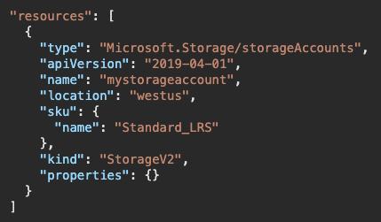
Alternatives and similar tools
Google know about:
Azure ARM templates link
Azure CLI link
Bicep by Microsoft link
Ansible link, link
Packer by HashiCorp link
Pulumi link
SaltStack link
Azure Automation link
Chef link
vRealize Automation link
Google Cloud Deployment Manager link
AWS Service Catalog link / AWS Cloud​Formation link
Puppet link
Vagrant by HashiCorp link
Cisco Intersight link
…
Notes:
When we try googling terraform alternatives, first result page contains information about tool on the slide.
I know and have experience only with part of the list.
Based on experience with terraform, I would like to say that:
- tools from the list have different functionality
- several tools can do little another, can have extra features or some features can be missed
- several tools can’t be used like Terraform because cover only small part of features
- part of it open-source, other not
- several can work only with specific cloud

Slide 16
Why Terraform?
Opensource
Mature and Cutting Edge
Provisioning tool
Cloud agnostic syntax
State instead Master server/Agent
Large community
Declarative syntax (vs procedural)
Simple and powerful language
Immutable infrastructure
Terraform provides a flexible abstraction of resources and providers. This model allows for representing everything from physical hardware, virtual machines, and containers, to email and DNS providers. Because of this flexibility, Terraform can be used to solve many different problems. This means there are a number of existing tools that overlap with the capabilities of Terraform. We compare Terraform to a number of these tools, but it should be noted that Terraform is not mutually exclusive with other systems. It can be used to manage a single application, or the entire datacentre.
Notes:
Copy-paste from terraform official site you can see on screen.
- Terraform opensource and I can check how it works. I used it once and it was helpful.
- Terraform is provisioning tool. We can do a lot with different providers. But can use terraform like configuration tool too.
- Terraform cloud agnostic. It doesn’t mean that app services can be created in Azure/Google/Amazon clouds with one piece of code. It means that approach the same, names and types of resources cloud specific.
- Terraform use state files and do not have dependency to some server/agents/demons. Not require update it, manage etc.
- Difficult to compare Terraform community with another community for Terraform alternatives. But looks like Terraform has the biggest community.
- Declarative syntax. Simple and clear. From another site terraform files can be huge, and modules try to solve it.
- Terraform modern tool but cover a lot and can do a lot.
- In case any manual changes terraform will try to roll it back. But it depends on provide and implementation. I saw how it works sometimes and sometimes not.
Terraform not an ideal tool that can solve all possible problems but cover almost all of them. And of course, add new. But the quantity and quality of positive points covers all negative points.
In case you are thinking about using it or not. My advice is to try to use Terraform.

Slide 17
What next?
Remote state
Other providers
Modules
Terraform in CI/CD pipelines
null_provider
Unit Testing
Security check
Terraform Cloud
Tools
…

Slide 18
QUESTIONS

Slide 19
THE END

